Slide 1
Object Oriented Programming CSC8101
Class Presentation Refugee Biodata Verification API System
National Social Security Fund Verification Portal – Accessing data from Office of the Prime Minister –Department of Refugees Database.
Name: Noel Ikwap Access Number: B35094 Registration Number: S25M19/017
Class: Master of Science in Data Science and Analytic

Slide 2
The Problem Context
The National Social Security Fund (NSSF) needs a secure, automated method to verify refugee identities.
Current verification via email is: Slow, Manual and error-prone, Not suitable for real-time systems
The solution: Create an API that connects NSSF systems directly to the Office of the Prime Minister’s (OPM) refugee databases:

Slide 3
Why is this Project Important?
Enables NSSF to open savings accounts for refugees legally working in Uganda.
Supports employers who remit monthly contributions.
Allows identity verification before money is deposited, especially for returning refugees.
Complies with: Uganda Data Protection and Privacy Act (2019), Security and confidentiality rules in the Terms of Reference
Protects sensitive refugee information.

Slide 4
Project Scope
Develop a FlaskAPI for verifying refugee biodata.
Create synthetic (fake) data resembling OPM’s databases.
Implement secure API key authentication.
Build verification logic returning: "Match“ "No Match“ Basic biodata fields

Slide 5
Technical Approach
Programming Language: Python
Framework: FastAPI
Database: SQLite + SQLAlchemy
Validation: Pydantic
Server: Uvicorn
Configuration: python-dotenv
This combination ensures: Fast API performance, Easy data modeling, Strong validation, Lightweight deployment

Slide 6
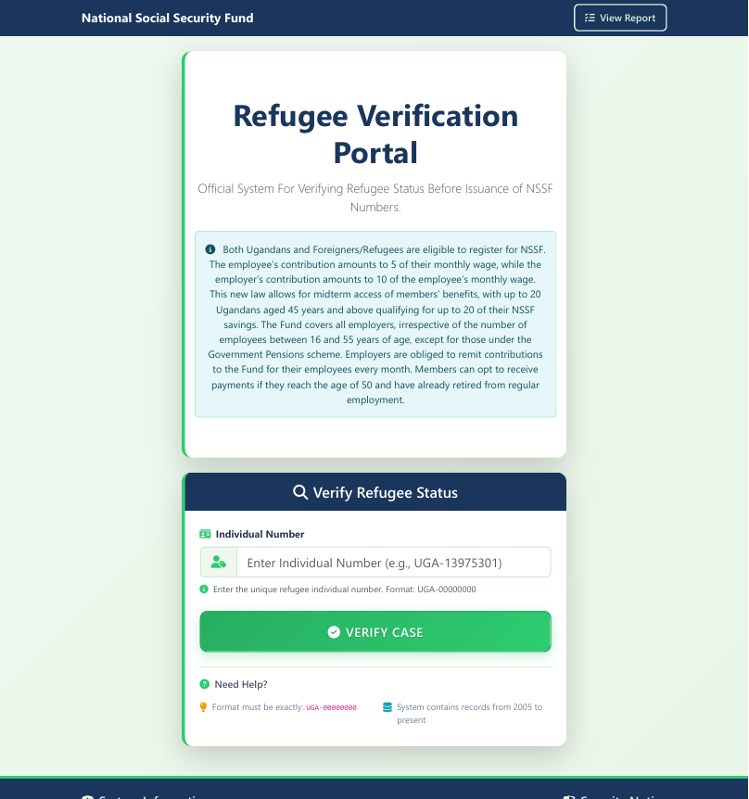
Database Design and Landing Page
individual_number
process_status
family_group_number
full_name
family_size
age
gender
country_of_origin
legal_status
location_address
date_of_birth
registration_date
created_at

Slide 7
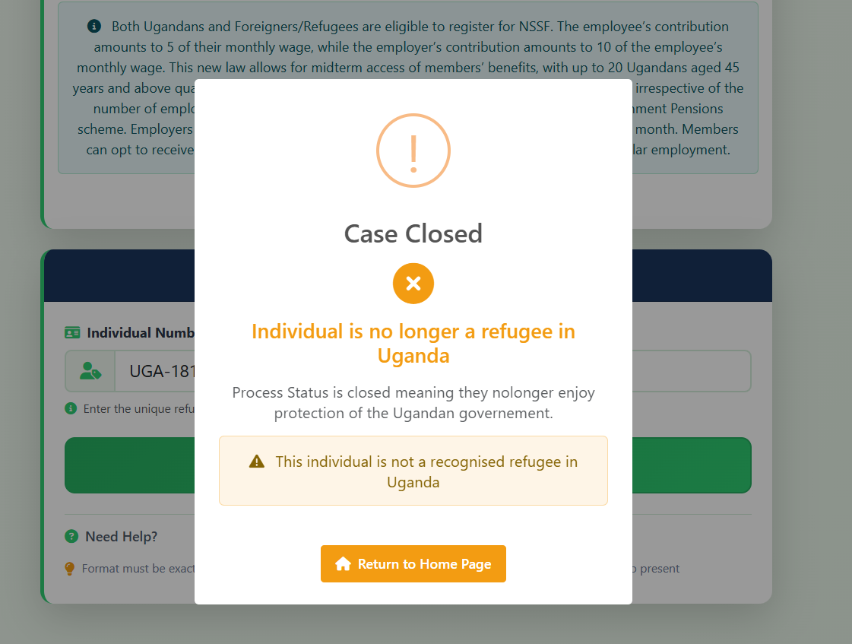
How the APP handles Closed cases illustration
If the case has a process status of closed, irrespective whether they are refugees or asylum seekers, it rejects the case and returns a message saying individual is nolonger a refugee in Uganda. Process status is closed meaning they nolonger enjoy protection of the Ugandan government hence they do not qualify for any services in Uganda including NSSF. Snapshot below shows that pop-up.

Slide 8
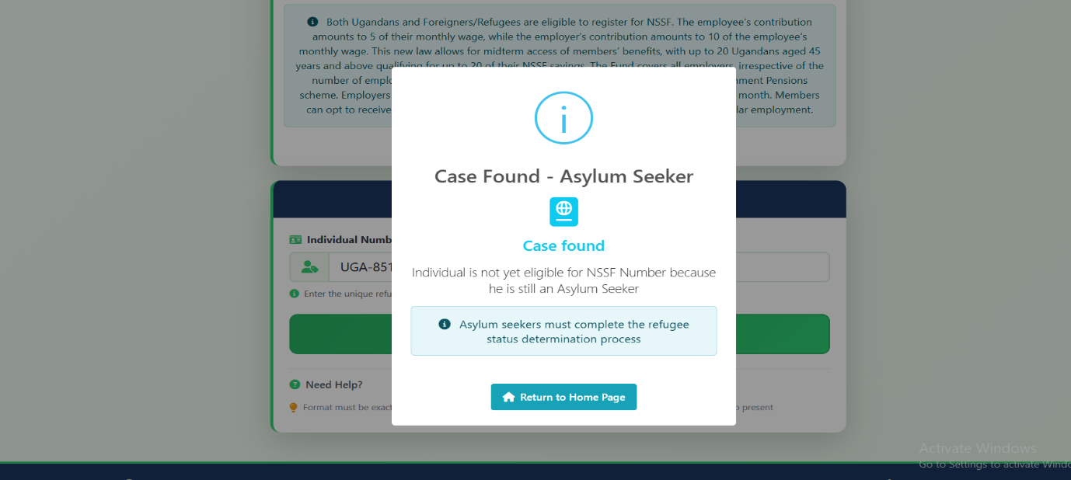
How it handles Asylum Seekers
If the case is Active (process_status) and legal_status is an Asylum seeker it displays “case found -Asylum seeker and since Asylum seekers are not eligible for NSSF Numbers, it says “individual is not eligible for NSSF Number because he is an asylum seeker, asylum seekers must complete the refugee status determination process. It rejects the case nevertheless.

Slide 9
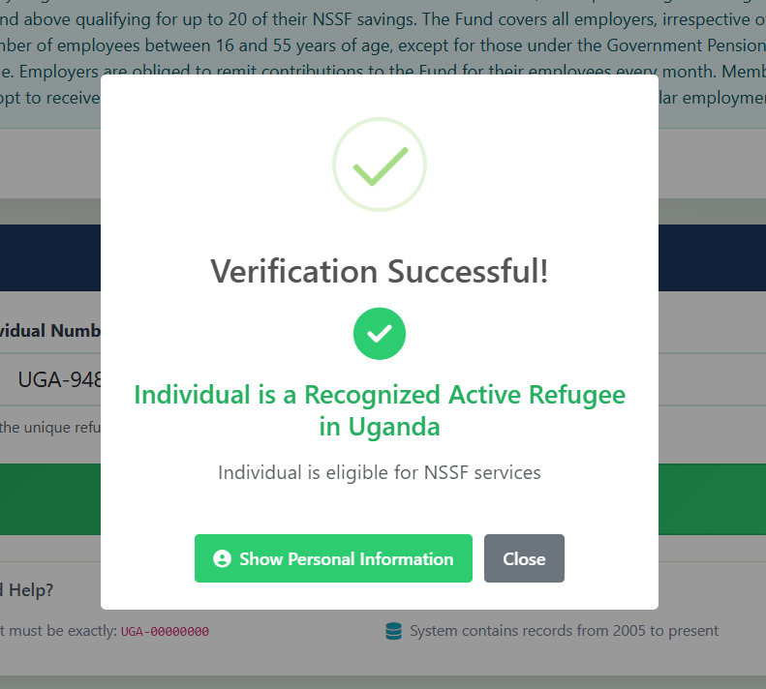
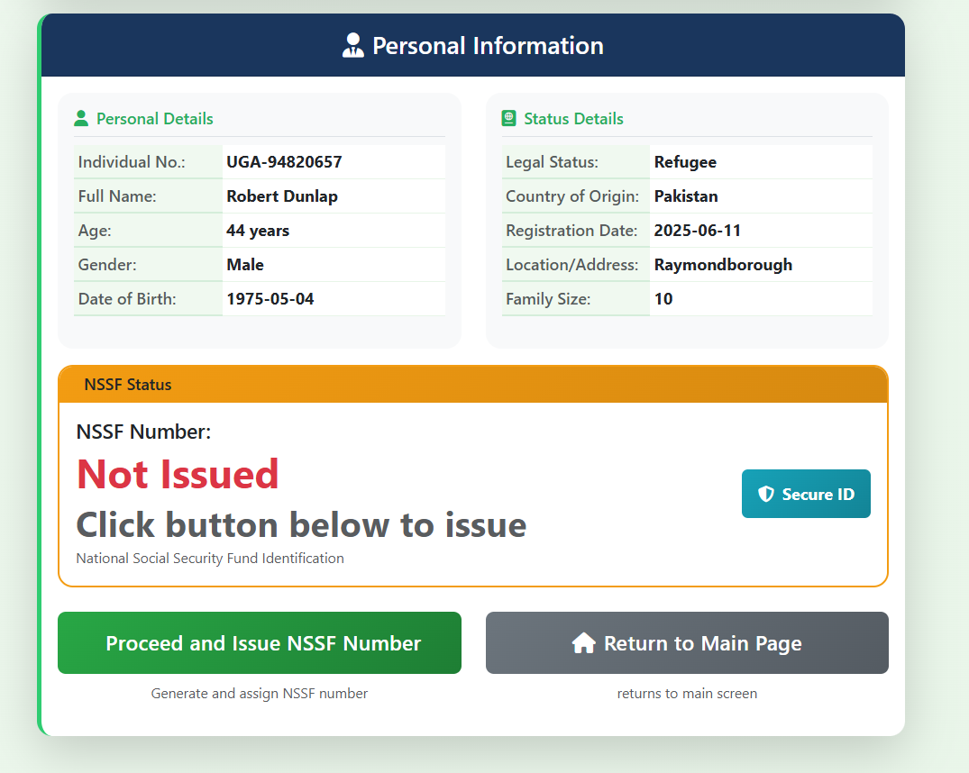
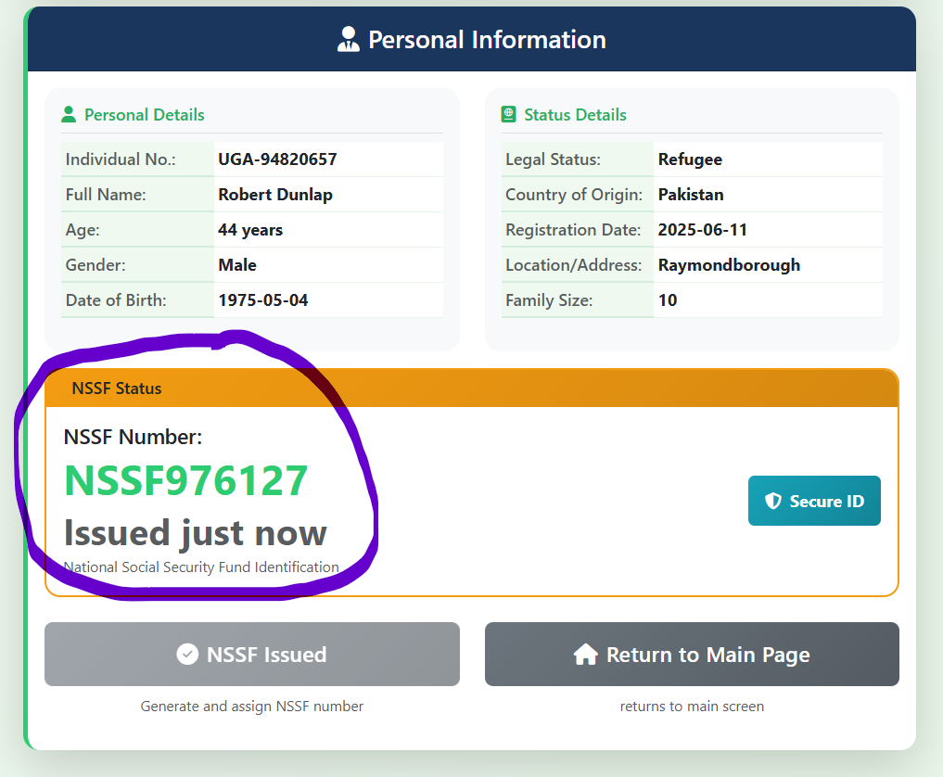
If case is Active Refugee

Slide 10
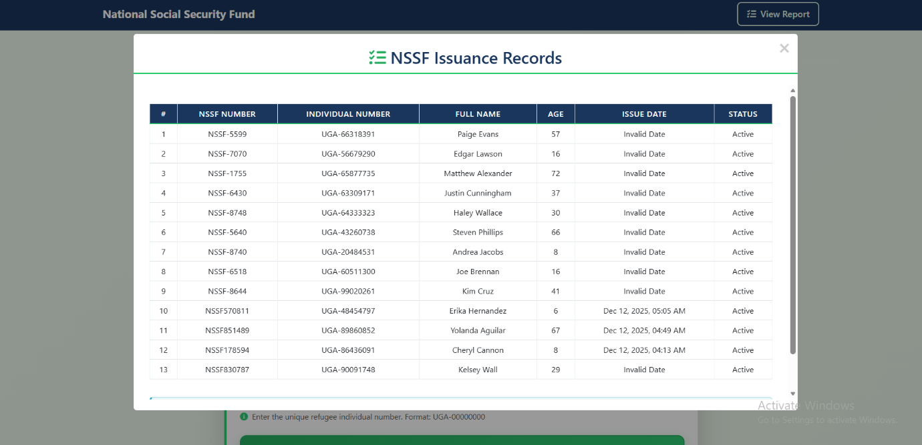
Minors handling
Incase one needs to view the number of cases issued with Nssf numbers, they can click the view report link at the top right corner of the application to view the report and the report will be displayed as seen below.

Slide 11
Q&A
Thank you!

